Slide 1
24
7
30
Algebra
Date
EQ – Describe how we use the distributive law to expand brackets
PBS MATH CLUB Video
Distributive Property – Friendship Bracelets and Oprah
(first 1 min 50s)
https://youtu.be/n99K96Ektqo

Slide 2
24
7
30
Algebra
Date
EQ – Describe how we use the distributive law to expand brackets
What is the distributive law?
The best place to start is with a mathematical expression:
a(b + c)
The distributive law is the process of distributing the number or variable on the outside of the brackets to every term inside the brackets. It looks like this:
+
a x c
=
ab + ac
a(b +c)
=
a x b

Slide 3
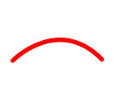

24
7
30
Algebra
Date
EQ – Describe how we use the distributive law to expand brackets
Distributive Law
2 (y + 3) = 2xy + 2x3 = 2y+6 The “2” outside the brackets multiplies onto all letters and numbers that are inside the brackets.

Slide 4

24
7
30
Algebra
Date
EQ – Describe how we use the distributive law to expand brackets
2 (y + 3) = 2xy + 2x3 = 2y+6
The “2” outside the brackets multiplies onto all letters and numbers that are inside the brackets.
4(4e - y) = 4x4e – 4xy = 16e – 4y The “4” outside the brackets is multiplied onto everything that is inside the brackets.

Slide 5
24
7
30
Algebra
Date
EQ – Describe how we use the distributive law to expand brackets
2 (y + 3) = 2xy + 2x3 = 2y+6
The “2” outside the brackets multiplies onto all letters and numbers that are inside the brackets.
4(4e - y) = 4x4e – 4xy = 16e – 4y The “4” outside the brackets is multiplied onto everything that is inside the brackets.

Slide 6
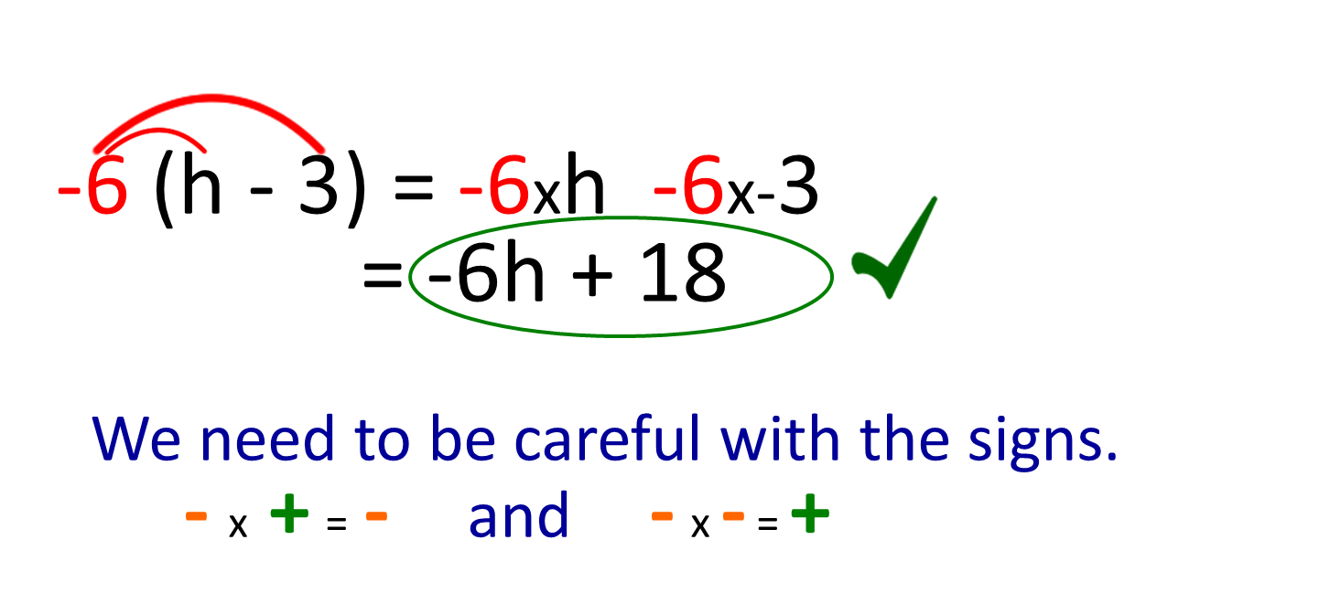
24
7
30
Algebra
Date
EQ – Describe how we use the distributive law to expand brackets
4(4e - y) = 4 x 4e – 4 x y = 16e – 4y
What happens with negative signs?

Slide 7
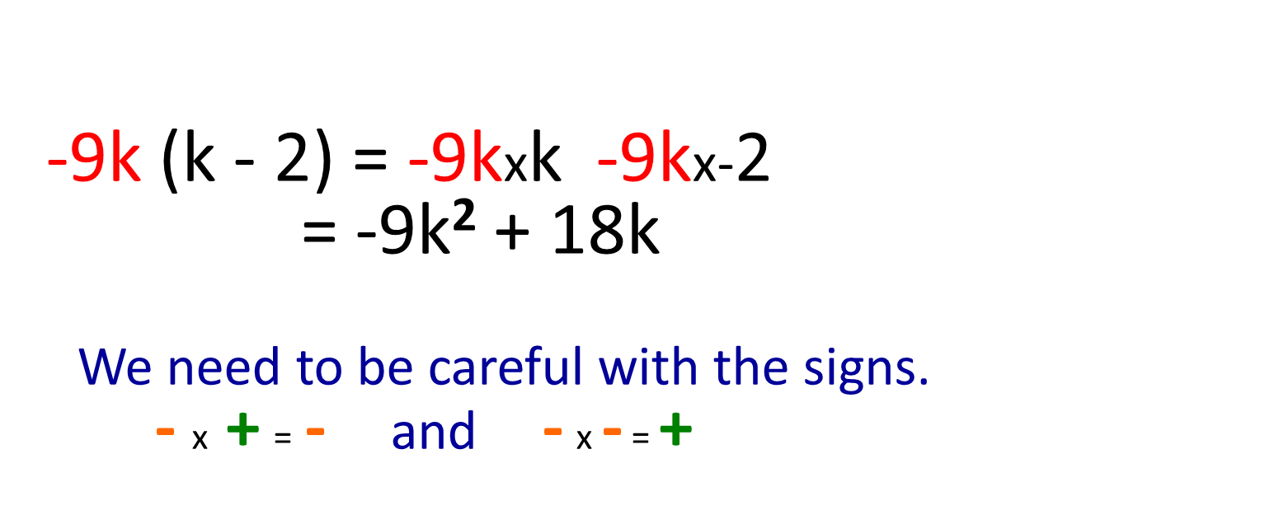
24
7
30
Algebra
Date
EQ – Describe how we use the distributive law to expand brackets
What happens with indices?

Slide 8




Now it’s your Turn

Slide 9
Which statement demonstrates the distributive property incorrectly?
3(x + y + z) = 3x + 3y + 3z
(a + b) c = ac + bc
5(2 + 3x) = 10 + 3x
6(3k - 4) = 18k - 24
Answer this as an Exit pass from class

